Slide 1

2025 Marketing Communication Strategy

Slide 2



Where we were … from 2021 to today
ITALY/EUROPEAN PR AGENCY
(Notiziabile)
ACTIVE SOCIAL: Facebook, Linkedin, X (twitter)
USA PR AGENCY
(Sarah Nickell Communication)
All contents about announcement briefed and structured internally
LOCAL JOURNALIST
( Il sole24 ore, Forbes)

Slide 3

What shall we improve …. (general)
Institutional connection with the main local agencies linked to
Italy/ European Space Sector Institutions (AIPASS….ASI…ITA/ICE)
Focus on USA channel → catch project integration opportunities to open new visibility
Gain more visibility by leveraging our clients or partners: when we support a launch or a particular program, being mentioned in their PR or social media posts increases our visibility and helps strengthen our position in the market.
When we sign a contract and are selected to support a mission, we commit to proposing joint communications. Teams needed: Sales, Legal
Podcasts and radio shows
Technical Paper new project accreditation (Bere released the process : how to better place our contribution during the events)
Budget plan understanding for the new confirmed project
Suggest the event organizing team a list of panel topics that we can participate in, every time we register

Slide 4
What shall we improve ….(detail)
1. European Space Policy Institute (ESPI)
Goal:
Strengthen positioning in shaping European institutional space policy
Benefits:
Access to a strategic network on European space policy.
Direct presence in Vienna (United Nations) and Brussels (European Union) = central role in international forums.
Insights into regulatory and geopolitical trends.
Action:
Evaluate opening a formal representation or assigning a dedicated figure in Brussels and/or Vienna.

Slide 5
What shall we improve ….(detail)
2. Global Satellite Operators Association (GSOA)
Goal:
Position Leaf among major global players and learn advanced lobbying practices.
Benefits:
Improve direct dialogue with major satellite operators.
Sharing of best practices in governance, spectrum policy, and network resilience.
Strategic alliance opportunities.
Action:
Join the association and actively participate in thematic working WW groups.

Slide 6
What shall we improve ….(detail)
3. World Teleport Association (WTA)
Goal:
Build a professional and credible image in the ground segment.
Benefits:
Access to certifications, audits, and quality benchmarking tools.
Opportunities for collaboration with global teleport operators.
Recognition of Leaf's operational capabilities.
Action:
Apply for certification programs and contribute to case studies

Slide 7
What shall we improve ….(detail)
4.International Astronautical Federation (IAF)
Goal:
Increase global visibility, especially in emerging countries.
Benefits:
Relations with small-to-medium space agencies.
Opportunities to work alongside major contractors (e.g. Airbus, Thales)
Confirmation of presence in the International Astronautical Congress (IAC)
Action:
Submit papers or sessions to IAC and take part in industry committees.

Slide 8
What shall we improve ….(detail)
5. European Association of Remote Sensing Companies (EARSC)
Goal:
Strengthen European presence in the Earth Observation (EO) sector.
Benefits:
Networking with key EO players in Europe.
Access to collaborative funding opportunities (e.g. Copernicus, Horizon).
Visibility with ESA and the European Commission (DG DEFIS).
Action:
Actively join policy tables and technical task forces.

Slide 9
What shall we improve …(detail)
6. AIPAS (Association of Italian Space Enterprises)
Goal:
Become more proactive in the Italian institutional landscape.
Benefits:
Direct channel with ASI and relevant Ministries.
Active role in shaping Italian space policy and roadmaps.B2B collaboration opportunities with innovative Italian companies.
Action:
Take on an active role in internal committees and propose joint initiatives.

Slide 10
Introduction

Slide 11
Introduction
Status quo: To make Leaf Space “the default choice for up-and-coming commercial operators and begin exposure to institutional customers” in Europe & the US and
Reach expert customers working with KSat & EU institutional market
US commercial
IT/EU institutional

Slide 12
Executive Summary
• Multi-channel comm:
Social (LinkedIn, X)
Targeted ads (LinkedIn, Google Ads)
Media relations, Conferences
CEO thought-leadership articles
AI copilots
Experiments
Tailored content for target geography
Tweet during LEOP
Two core personas (Fast moving Innovator & Steady Pioneer)
Launch Leaf Hosting and Leaf Key

Slide 13
North-Star Objectives & KPIs
Positioning: New Space Actor → Trusted, professional established provider
In Six months • Brand
KPI 1: Convince three top customers to publish their collaboration with us
• Visibility
KPI 2: 25k -> 30k LinkedIn impressions/mo;
KPI 3: 2 media mentions/quarter
KPI 4: ≥2 qualified webinar leads/mo
• Engagement –
KPI 5: 6 % CTR on thought-leadership articles

Slide 14
Social Media
LinkedIn and X will be primary social channels moving forward as , they’re still the platforms used primarily for B2B marketing
Linkedin (Cadence: 2-3 posts per week)
Technical insights
Customer wins
New Ground stations
Expert topic posts : for ex: Cybersecurity
X ideas (Cadence: 2-3 posts per week)
Live tweet LEOP sessions? (for ex.: we signal locked our first satellite, photos of MM working, perhaps a waterfall without the name?)
Engage with customer accounts and retweet their updates for every launch

Slide 15
Website
Press Release (2 by EOY 25)
Upcoming Events on website
New Service Pages: (Design and Deployment)
Leaf Key
Leaf Hosting

Slide 16
Sponsored Advertising
LinkedIn
Continue weekly posting
Use it to increase exposure to institutions on what we’re already doing.
According to Bere’s analysis, there are two segments of institutions (one who doesn’t see the value in working our way and another which does). For the latter, the fact that we’re working with 120+ satellites already will be a good signal.
Google Ads (Evaluation: Start Small)
Different from LinkedIn advertising, we can target people who search google for satellite ground segment, LEOP support etc. -> Helps us reach the right audience earlier
Sponsored Articles
Payload: Could help us increase the exposure. Four articles every six months
Spacenews

Slide 17
Google Ads - Terms
Ground segment services: ground segment as a service, ground‑station network, ground segment provider, satellite ground services, GSaaS
Antenna/ground infrastructure: satellite ground antennas, ground station rental, S‑band ground station, X‑band ground station ,Ka‑band ground station – capturing operators searching for specific hardware or frequency bands.
Satellite operations: satellite operations support, telemetry and command services, TT&C support, LEOP communications.
Cost and build vs. buy: ground station cost, build own ground station, ground station outsourcing, make or buy ground segment.
Typical B2B spends 3-4 dollars per click – Aerospace industry maybe higher or lower
We could start with 125 Weekly spend and see how much its costing us to get clicks to Leaf Space Website

Slide 18
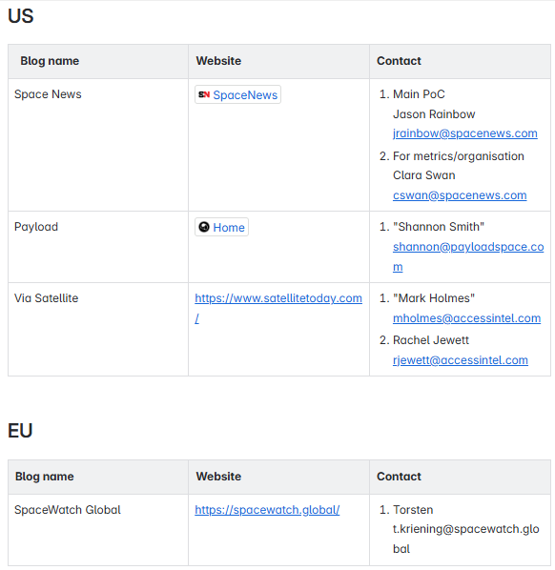
Media Publishing
Italy
Wired
Il Sole di 24 ore
Nowtilus media
Global
1. Payload EU and Payload Global [4 issues throughout the year at 2000 euros]
Payload next four articles
Europe
Spacewatch global`
Task: Research new publishings

Slide 19
Increase Engagement at Conferences
Brochures/Ipads
More presence in panels and papers
An idea out there in the realm
Can we use the demo made by Luca and rest of the team?

Slide 20
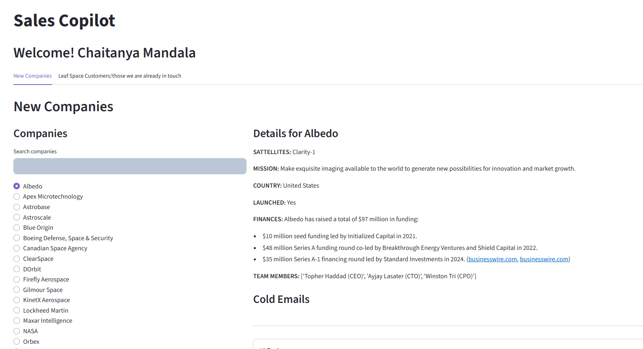
AI Sales Tools
New task: Include insights from filings to get more info about selected companies

Slide 21
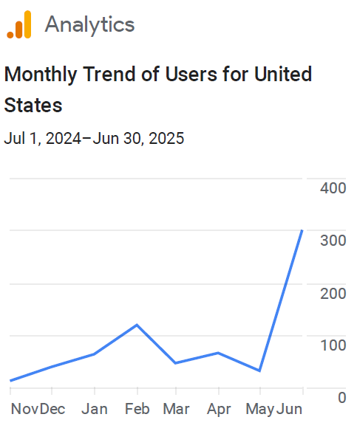

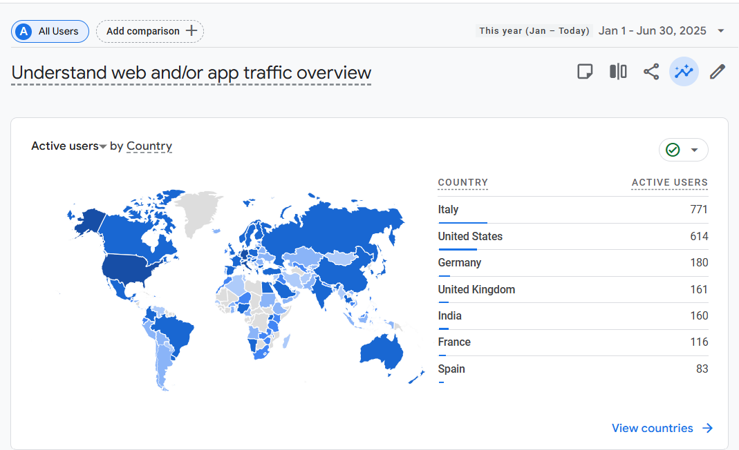
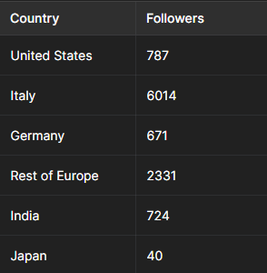
Current Status

Slide 22
United States
Position Leaf Space as the reference ground segment provider
Our Goal
Strengths
Leaf Space is established space commercial players
Commercial contracts increasing
Cost and flexibility
Weakness
We don’t have cybersecurity compliance certificates(for companies working with gov, we might not be a choice)
Perceived still as a foreign/Italian company
Become a trusted partner for Commercial Companies
Our
Positioning
Shift perceptions from Leaf Space being a smallsat/new space actor (young team) to a very professional, established and trustable organization
Promote USPs based on pain points
Use US media Payload, SpaceNews , Via Satellite to publish articles every quarter
Key Results
Our
Impact

Slide 23
Italy/Europe
Position Leaf Space into Institutional/Gov landscape to get fundings and grants from direct/indirect Italian Gov
Strengths
Leaf Space is established space commercial players e.g. D-Orbit, Argotec
Commercial contracts are increasing
Leaf Space can be the natural partner for European space companies
Weakness
Leaf Space has not enough exposure into Gov/Institutional landscape
Currently, Leaf Space doesn’t receive any fundings / grants
Our Goal
Become a trusted partner for Gov/Institutional organizations
Our
Positioning
Shift perceptions from Leaf Space being a smallsat/new space actor (young team) to a very professional, established and trustable organization
Define a specific offering (Leaf Key -> Leaf Exclusive) to address this target customer segment and go after small size project to address the segment (use partners)
Drive awareness about this new “Product line” toward the target audience
Key Results
Our
Impact

Slide 24
India
India has begun giving more funds to commercial space sector.
Linkedin: target employees of Indian newspace companies (satellite startups, space tech SMEs) and ISRO/DoS personnel (many senior ISRO scientists are on LinkedIn). India’s context, e.g. “Supporting India’s next-gen satellite missions – Trusted by Pixxel” to leverage social proof.
Currently we attend the conferences since 2022
Regional Publications
Economic Times Aerospace
Geospatial World (a media outlet popular in India’s space/geo community)
KPIs:
Indian website traffic growth
Registration on website from India
Number of companies reaching out to Jai

Slide 25
South Korea
Korea Aerospace Research Institute (KARI) and Korean Aerospace Adminstration(KASA)
Target employees from above to improve visibility
Currently we attend the conferences since 2022
KPIs
LinkedIn visibility growth from Korea
Website Views

Slide 26
Summary
Platform | Frequency | Costs
LinkedIn | 2 posts/weekly | None
Press Release Website | 2 PRs EOY 25 | None
Expert thought leadership posts | 2 EOY 25 | None
Media Publishing | 3-4 EOY 25 | 2000/quarter
Sponsored Advertising | Weekly campaigns | 300 Euros/monthly

Slide 27
Q3
Q4
Q3 | Budget Allocated:$$XX
Performance Measurement & Reporting vs KPI’s
Inspirational Narrative Ark: Leaf Space is democratizing access to space, empowering a diverse range of users with affordable and user-friendly ground segment solutions that unlock the potential of the space economy for everyone
Launch new content across Linkedin
Define Agreements with Media Publications
Payload/Space News article 1: Product Launch
Payload article 2
Launch of “Smart Integration” Functionality
SDN (End-to-End Product) Launch Preparation
Reach out to customers for collaborations
Launch of Leaf Key (Dedicated Ground Station Offering)
Budget Reallocation
Press Release-1: New Product
Press Release 2
Press Release 3
Analyze how to market in secondary markets
Linkedin Campaign
Budget Allocated: $$XX
Budget Allocated: $$XX
CEO Thought Leadership Post 1
CEO Thought Leadership Post 2
CEO Thought Leadership Post 3
Target KPI’s: XX/XX/XX
Target KPI’s: XX/XX/XX
Target KPI’s:
Q4 | Budget Allocated: $$XX
Inspirational Narrative Ark: Leaf Space is democratizing access to space, empowering a diverse range of users with affordable and user-friendly ground segment solutions that unlock the potential of the space economy for everyone
Payload article 3
Payload article 4
Customer Testimonials at the event
Press Release-4: New Product
Press Release 5
Press Release 6
Linkedin Campaign
Initiate experimenting with Google Ads
CEO Thought Leadership Post 4
CEO Thought Leadership Post 5
CEO Thought Leadership Post 6
Target KPI’s:

Slide 28
Questions
What are the options for public funding that Leaf Space can get? PNRR?
ASI funding (pay for our R&D)
Lombardy govt. ?
PNRR fund ? (Check if the money is available)
Italian govt. (research projects)
What are the platforms/conferences we can target institutions?
Platforms:
Conferences: (Ask Gio and Aldini)
Which proof points are these institutions looking for that’ll make them choose Leaf ?
Italian champion Leaf (Revenue:4 Mln euros, growing customer base, growing satellites)
Tax payer with export business
Can we work with AIPAS to get funding? (Ask Gio)
Action Items
Institutional page on Leaf Space website
Get security compliance certificate
Bring Lombardy govt. to office and convince them to invest in Leaf Space?

Slide 29
Key decision makers
Person | Role | Overview
Minister Adolfo Urso (https://www.mimit.gov.it/en/minister-urso) | Minister of Enterprises & Made in Italy (MiMIT) | November 21, 2022, the Prime Minister delegated him the coordination of space and aerospace policy.
Alfredo Mantovano-Under-Secretary to the Prime Minister | https://decode39.com/10827/meloni-puts-space-strategy-at-pmos-core/ | 2 April 2025, a seven-page, nine-article decree signed by Under-Secretary Alfredo Mantovano established a “single point of contact for the resilience of critical entities” under the Italian Prime Minister’s Office (Palazzo Chigi).
Gen. Franco Federici – Military Advisor to the PM | https://decode39.com/10827/meloni-puts-space-strategy-at-pmos-core/
Teodoro Valente – President, Italian Space Agency (ASI) | https://www.reuters.com/technology/space/private-investments-space-are-essential-head-italian-space-agency-says-2024-10-13/ | Controls ASI’s R&D and commercialisation grants; publicly champions private-sector investment in space.

Slide 30
Communication Strategy Italy
Weaknesses
Leaf Space has not enough exposition into Gov/instit landscape
Leaf Space rcurrently receives no fundings / grants
Strenghs
Leaf Space is established space commercial players
Commercial contracts increasing e.g. Argotec,D-Orbit
Our Positionning
Goal
Position Leaf Space into Instit/gov landscape to get fundings and grants from direct/indirect Italian gov
Our Goal
Become the first GSaaS choice for med/big size established satellite operators and remain the preferred choice for new sat operators
Become a trusted partner for Gov/Institutional organizations
Our
Main axis of development
Create a new “Story line” through new functionalities that allows med/big customer to work with Leaf Line (Priority TBC)
Shift perception of complex integration & On-boarding with Leaf Space to “No brainer” (challenge : booking method with both On-demand)
Shift perceptions from Leaf Space being a smallsat/new space only actor (young team) to a very professional, established and trustable organization
Define a specific offering (Leaf Key -> Leaf Exclusive) to address this target customer segment and go after small size project to address the segment (use partners)
Drive awareness about this new “Product line” toward the target audience
Explain how to create a viable space to earth communication strategy and conops to satellite operators and position Leaf Space as an opinion leader(radio selection, licensing...)
Redefine the space to earth contact scheduling methodology to help satellite operators adopt modern techniques to benefit from greater flexibility and affordable pricing
Our
Thought
Leadership
Shape the
Future of Space to Earth Communication strategy/Conops
Key Results
Activate 5 customers generating > 250 K€ per year
Get 5 mid/big size customers to commit on capacity over Leaf Line
Close 5 deals/projects for govt./institutional customers (2nd level players)
Our
Impact

Slide 31
Audience 1: Commercial operators
Fast Moving Innovator (commercial start-ups) Needs plug-and-play, transparent pricing, values flexibility and tech advancements
Pain | Promise
Lack of RF & licensing knowhow | Handle licensing, integration and testing
Dev-team has limited bandwidth | RestFUL API for integration and operations along smart scheduling freeing your devs for the core product
Surprise expenses | Pay only for the minutes you use. When your constellation explodes in size, your ground segment simply stretches.
3 a.m. stress for LEOP | Smooth LEOP

Slide 32
Audience 2: Institutions
Strategic Pioneer (gov/institutional) • Needs compliance & risk mitigation • Promise: Mission-critical
Pain | Promise
Sovereign-data | handle licensing, integration and testing
Cyber Security
Pressure to Buy European/Italian(EU Institutions) | Made while eating Pizzoccheri. (Italian Company)
Capacity Surge during emergencies | On demand capacity around the network

Slide 33
United States

Slide 34
Sponsored Content on Media Publications
SpaceNews
Payload EU and Payload Global [4 issues throughout the year at 2000 euros]
Space watch global
Via Satellite
The Hindu/Economic times (India)
Korea Economic Daily (South Korea)
Potential topics
Announcement of new ground station
Article on challenges of maintaining a global Supply chain
Notable win for a notable customer
Participation in a big project (IRIDE, ISRO etc.)
KPI
1. Published 2 major mentions quarterly 2. Can compare with Ksat’s mentions in similar magazines

Slide 35
Other Action Items
Identify conferences where panels are helpful → Reach out to them
Followup after conferences effectively
Take a photo with people from our best customers at the conferences

Slide 36
Podcasts
1. Access Hub: Space podcast 10000+ downloads across platforms

